Slide 1
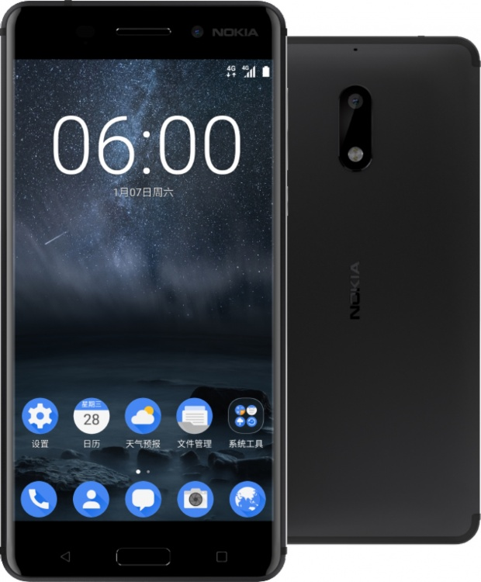
NOKIA

Slide 2
NOKIA

Slide 3
NOKIA
LEARN MORE

